Slide 1





ANKITA TANEJA
Data Analyst | Data Scientist | Machine Learning Professional
GitHub • LinkedIn • Web Portfolio

Slide 2

About Me
Turning Data Into Meaningful Insights
Passionate about leveraging statistical modeling, machine learning, and business analytics to solve complex problems.
Academic Excellence
Core Focus & Background
MSc Data Science — IIIT Bangalore / LJMU Pathway
Comprehensive technical background spanning software engineering, customer relationship systems, data engineering, and predictive analytics.
M.Tech — Computer Science & Engineering
B.Tech — Information Technology

Slide 3



Professional Journey
A progressive path combining core software development expertise with advanced data analytics and AI capabilities.
2016
2025 – 2026
Software Developer
Data Analyst Intern
2012 – 2013
2017
Present
Software Developer
CRM Specialist
Data Science & Analytics

Slide 4




Technical Toolkit
Programming
Data Analytics
Machine Learning
Deployment & Tools

Slide 5




Featured Projects
✈️
📈
💬
SkyPredict AI
Rossmann Sales
Amazon Reviews
Flight Price & Customer Satisfaction Prediction Dashboard.
Machine Learning Sales Forecasting & Time Series Model.
NLP Sentiment Analysis & Customer Feedback Classification.
📱
💰
💉
Mobile Usage Analytics
Personal Expenses
Vaccination Analysis
Exploratory Data Analysis, ML & User Segmentation Clustering.
Expense Tracking with Python, SQL & Interactive Streamlit App.
Global Immunization Data Analysis with MySQL & Power BI.

Slide 6




Project Spotlight: SkyPredict AI
End-to-End Travel Analytics System
Dual-model pipeline addressing ticket price volatility and passenger satisfaction drivers.
Problem & Data:
130K+ records processed across flight routes, delays, and passenger service ratings.
ML Performance:
Regression RMSE: ~₹1,420 | Satisfaction Accuracy: ~96.8% (XGBoost).

Slide 7




Data Analytics Projects
💉
💰
📱
Vaccination Analytics
Personal Expenses
Mobile Usage Analytics
Problem: Tracking global rollouts & regional disparity.
Problem: Budget tracking & spending pattern insights.
Problem: Understanding user app behavior segments.
Tools: Python • MySQL • Power BI
Tools: Python • SQL • Streamlit
Tools: EDA • ML • Clustering
Outcome:
Outcome:
Outcome:
Interactive executive dashboard tracking coverage rates.
Automated financial categorizer with live tracking UI.
K-Means user segmentation for targeted retention.

Slide 8








Machine Learning & AI
From Raw Data to Intelligent Systems
STEP 01
STEP 02
STEP 03
STEP 04
STEP 05
STEP 06
Data Ingestion
EDA Analysis
Feature Eng.
ML Modeling
Evaluation
Deployment
Regression
Classification
NLP
Price & Value Forecasting
Customer & Behavioral Status
Sentiment & Text Mining
Time Series
Clustering
Predictive Analytics
Sales Demand Forecasting
User Profiling & Grouping
Business Decision Intelligence

Slide 9
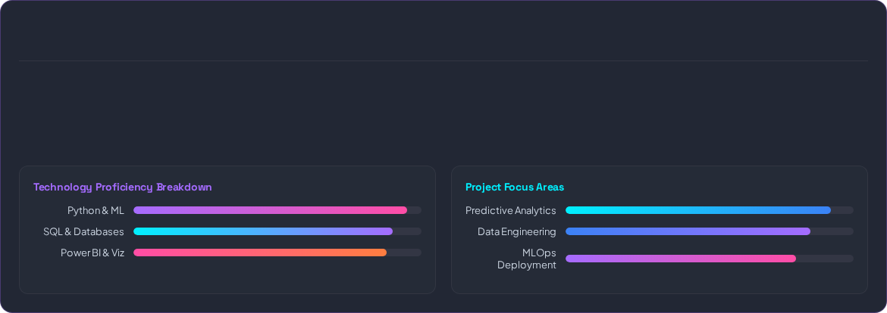






My Analytics Dashboard
ANKITA TANEJA
DATA ANALYTICS & ML PORTFOLIO
Featured Projects
Technologies Mastered
ML Models Trained

Slide 10

Education & Learning
Formal Education
Specialized Training
MSc Data Science
Advanced Machine Learning & Deep Learning
IIIT Bangalore / LJMU Pathway
Data Engineering & SQL Query Optimization
M.Tech — Computer Science & Engineering
Business Intelligence with Power BI
Postgraduate Degree
B.Tech — Information Technology
MLOps & Dashboard Deployment
Undergraduate Degree

Slide 11







Explore My Work
GitHub
LinkedIn
Live Portfolio
Open-source projects, clean Jupyter notebooks, and production code.
Professional updates, network interactions, and career achievements.
Interactive web applications, live demos, and case studies.

Slide 12



LET'S BUILD WITH DATA.
Ankita Taneja
Data Analyst | Data Scientist | ML Professional

Slide 13

Image Sources
https://cdn.dribbble.com/userupload/43350490/file/original-1ad115d2c03d9818d08df9931e046436.png?resize=752x&vertical=center
Source: dribbble.com

